Slide 1
MATHEMATICS | ALGEBRA FOUNDATIONS
Properties of Real Numbers
The rules that govern all arithmetic.

Slide 2

Overview

Slide 3


Slide 4
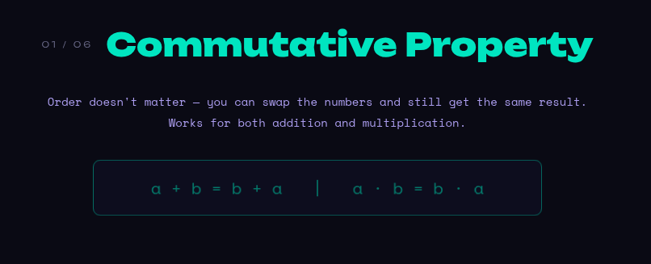

Slide 5
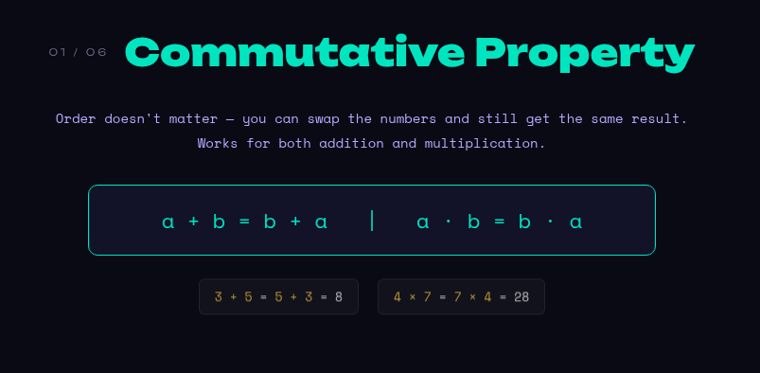

Slide 6
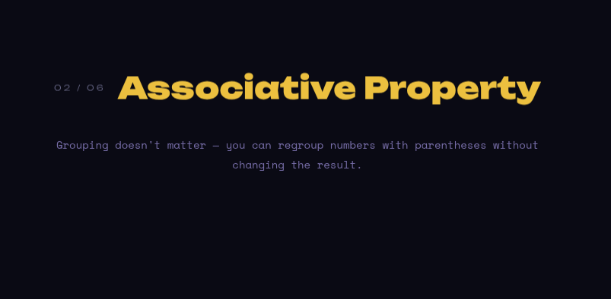

Slide 7
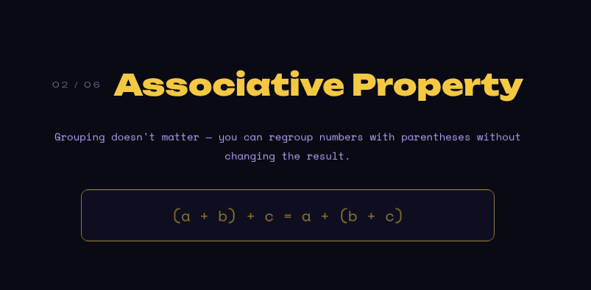

Slide 8
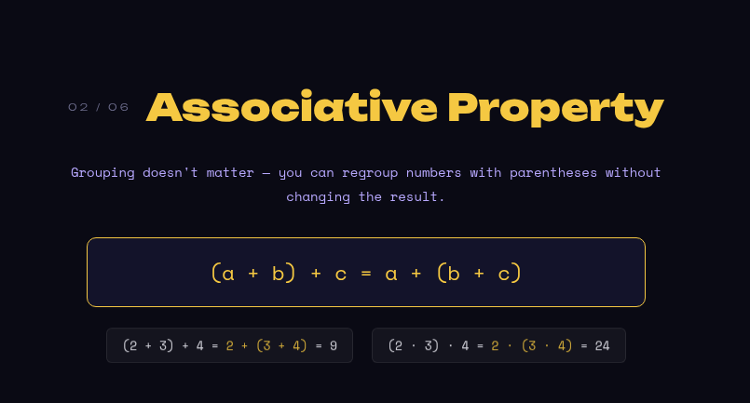

Slide 9


Slide 10
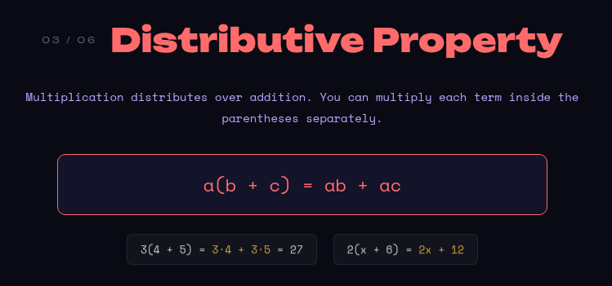

Slide 11


Slide 12
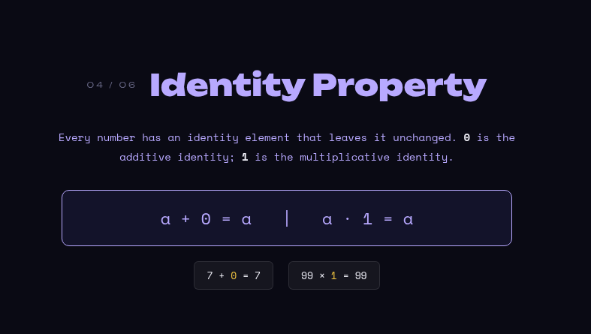

Slide 13


Slide 14
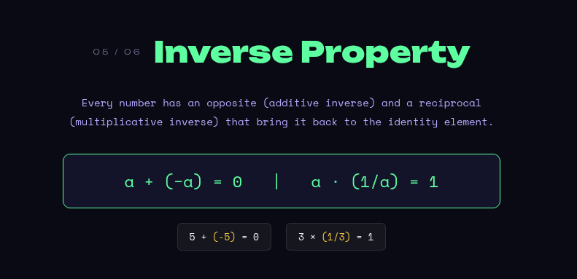

Slide 15
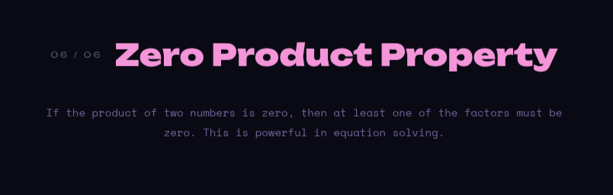

Slide 16
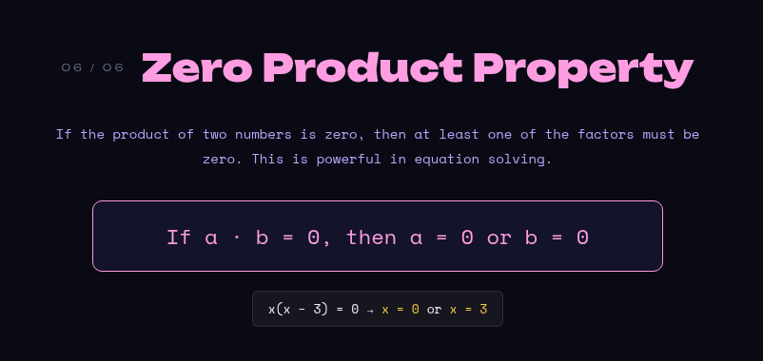

Slide 17
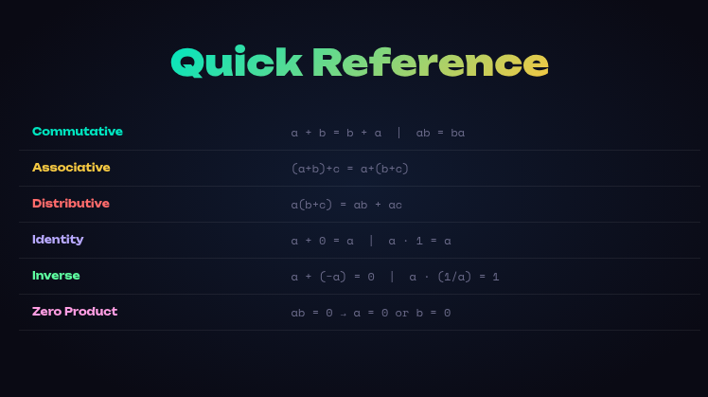

Slide 18
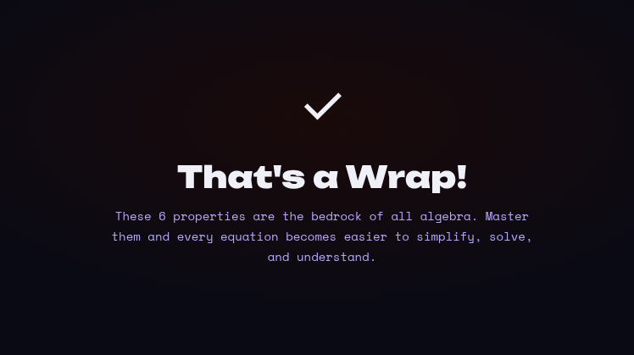

Slide 19
Ending
Master these… and algebra becomes EASY !
Like and Subscribe for more Math in Minutes.

